Slide 1
Is a catalyst always a necessity? A non-catalytic version of the borrowing hydrogen reaction.

Slide 2
Alkylation: C-N bond
Low atom-efficiency.
Over-alkylation.
An excess of reducing agent is needed.
Oxidation of the initial aldehyde derivatives.
More affordable reagents.
No oxidation of initial reagent.
2

Slide 3
Borrowing hydrogen reaction
3

Slide 4
Literary paradox
Yield
A: 1 mol%
, 110℃, DCE, 4 h, Ar
97%
B: No catalyst, 1 equiv. KO^{t}Bu, 90℃, toluene, 24 h, air (15 mol% of O₂)
75%
When can a reaction be carried out without a catalyst?
Vincent Guérin, Claude Y. Legault. Organometallics 2021, 40, 3, 408–417. (Editor’s choice)
Andrey S. Kozlov, Oleg I. Afanasyev, Denis Chusov. Journal of Catalysis 2022, 413, 1070-1076.
4

Slide 5
Bases variation
5
Notes:
Когда не нужен катализатор

Slide 6
Solvent variation
6

Slide 7
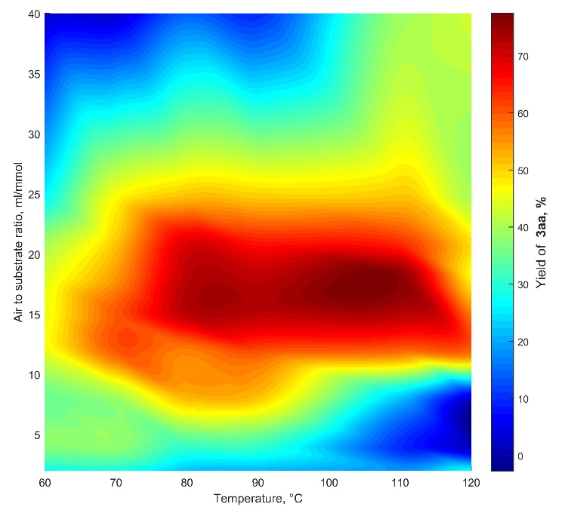
Influence of temperature and air volume
7

Slide 8
Substrate scope
8

Slide 9
Limitations
9

Slide 10
Limitations
10

Slide 11
Bordwell acidity of N-nucleophile
11

Slide 12
Mechanism without catalyst
Andrey S. Kozlov, Oleg I. Afanasyev, Denis Chusov. Journal of Catalysis 2022, 413, 1070-1076
12
Notes:
Когда нужен катализатор

Slide 13
Summarized successful conditions
Evgeniya Podyacheva, Oleg I. Afanasyev, Dmitry V. Vasilyev, and Denis Chusov ACS Catalysis 2022 12 (12), 7142-7198
13

Slide 14
When is a catalyst required?
1. Low temperature reactions:
2. For inert substrates:
3. For unstable in base media functional groups:
14

